Slide 1
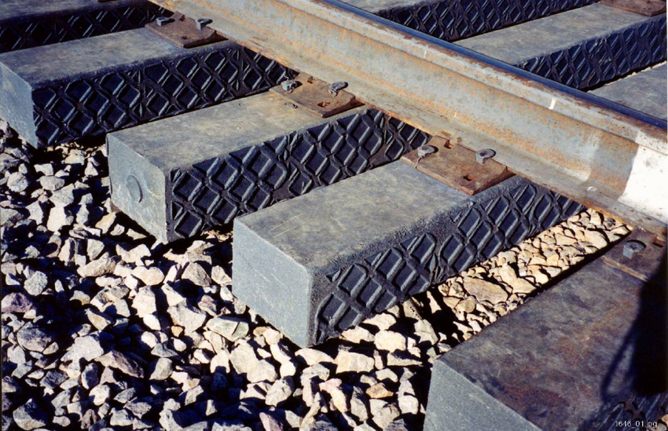
Composite Railway Crossties Status & Developments
Markku Vilkki, Conenor Ltd

Slide 2
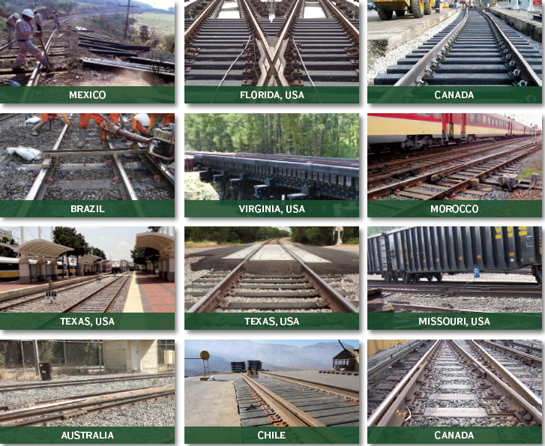
Composite Railway Crossties (known also as ”Sleepers”)
Over the past 20 years composite sleepers made from recycled plastics have become common standard products
several manufacturers all over the world inthe usa,russia,canada,japan,uk, germany,india,taiwan, Africa, thailand, netherlands and australia
composite railway sleepers are replacing existing concrete, steel and, particularly, timber ones in both mainline and heavy haul rail networks
references from one US manufacturer Axion

Slide 3
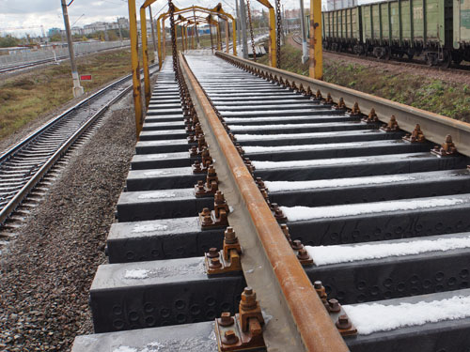
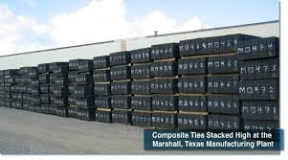
Benefits of Composite Sleepers
ENGINEERING
- Meet and exceed national standards
MORE DURABLE
- RESISTANT to rot, fungus, insects, and moisture
EASY-TO-INSTALL
- Installs using traditional wood-tie equipment
ENVIRONMENTALLY SAFER & CLEANER
- INERT Material and contains no toxic materials
GREEN SUSTAINABLE PRODUCT
- Made from 100% recycled material and are 100%
recyclable at the end of their longlife
PROVEN LONGER LASTING
- Resist plate wear, hold spikes, and maintain gauge accumulating WELL axle loads
Lower life cycle costs

Slide 4
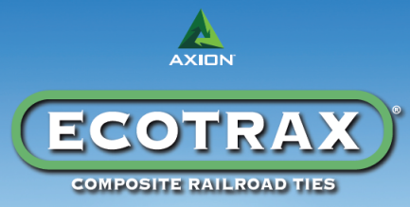
Manufacturers of Composite Sleepers
examples
http://www.axionsi.com/
http://www.atlasties.com/index.php
http://www.boiscommercialwood.com/catContent.asp?cat2ID=24
http://integrico.com/products/integrities/
http://www.tietek.net/product.asp
http://www.sicut.co.uk/
http://www.icsservices.com.au/wkg/pdfs/Carbonlocmanualgeneral5.pdf
http://tvema.com/catalog/support-systems.html

Slide 5
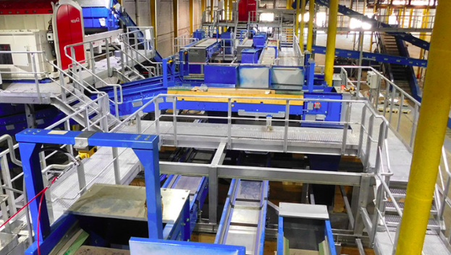
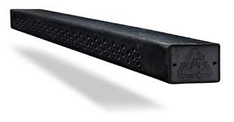
Manufacturing Process of Composite Sleepers
Manugacturing of composite sleepers in three steps;
Processing proper plastic waste
Production of composite material formulation with or without reinforcements
Production of sleepers
- by intrusion method
- by extrusion method

Slide 6
Intrusion Manufacturing Process of Composite Sleepers
Video in youtube from integrico
https://www.youtube.com/watch?v=8TzNUV-0Wls

Slide 7
Different Types of Composite Sleepers
Type-1 Sleepers with short or no fibre reinforcements
Sleepers that consist of recycled plastic (plastic bags, scrapped vehicle tyres, plastic coffee cups, milk jugs, laundry detergent bottles etc.) or bitumen with fillers (sand, gravel, recycled glass or short glass fibres < 20 mm)
Type-2 Sleepers with long fibre reinforcement in the longitudinal direction
Type-2 sleepers are sleeper technologies reinforced with long continuous glass fibrereinforcement in the longitudinal direction and no or very short random fibre in the transversedirection
Type-3 Sleepers with fibre reinforcement in longitudinal and transverse directions
Type-3 sleepers have long reinforcement fibres in both longitudinal and transverse directionsand consequently both the flexural and shear behaviour are dominated by fibres.

Slide 8
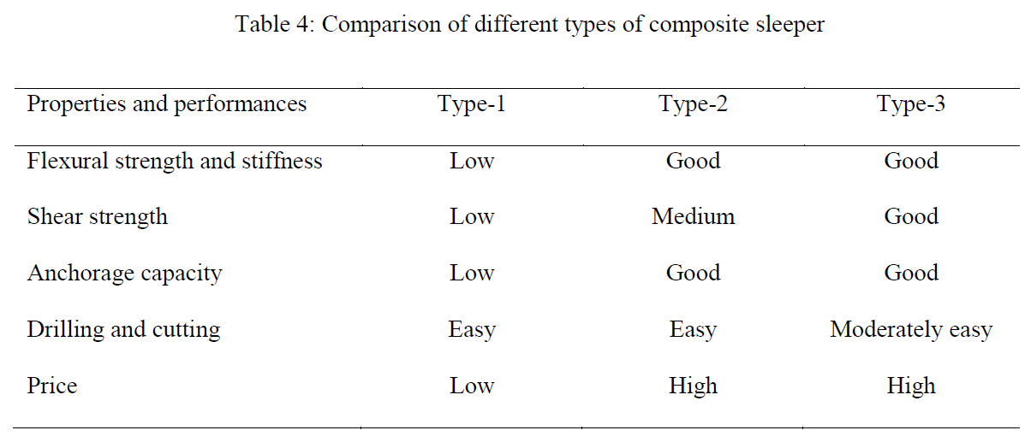
Different Types of Composite Sleepers
Source: Composite Railway Sleepers – Recent developments, challenges and future prospects / Article in Composite Structures · August 2015

Slide 9
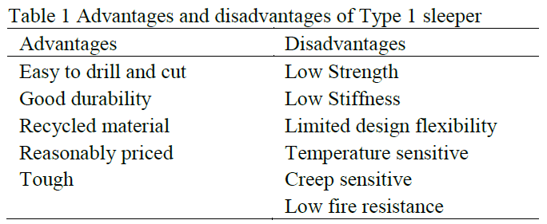
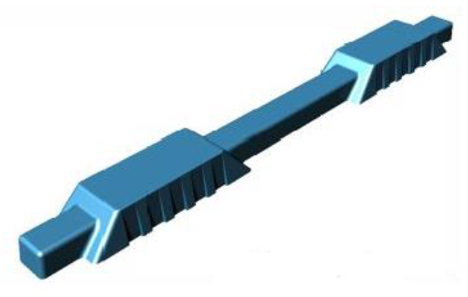
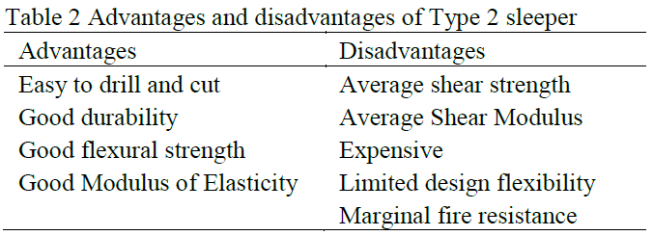
Comparing Advantages and Disadvantages of Composite Type1 and Type2 Sleepers
Source: Composite Railway Sleepers – Recent developments, challenges and future prospects / Article in Composite Structures · August 2015

Slide 10
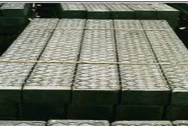
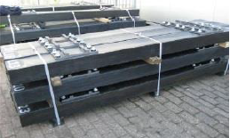
Summary of Composite Type1 Sleepers
The most common composite sleeper material, Type-1 sleepers offer a range of benefits including ease of drill and cut, good durability, consumption of waste materials, reasonable price, and tough.
However, it suffers from low strength and stiffness, limited design flexibility, temperature and creep sensitivity, and low resistance to fire.
The notable sleepers in this category are TieTek (USA), Axion (USA), IntegriCo (USA), I-Plas (UK), Tufflex (S-Africa), Natural rubber (Thailand), Kunststof Lankhorst Product KLP (Netherlands), Mixed Plastic Waste MPW (Germany) and Woodcore (USA).
Source: Composite Railway Sleepers – Recent developments, challenges and future prospects / Article in Composite Structures · August 2015

Slide 11
KLP® Hybrid Plastic Sleepers of Lankhorst in test track Sweden
Video in youtube from LANKHORST
https://www.youtube.com/watch?v=Fe84vp7FHM8

Slide 12
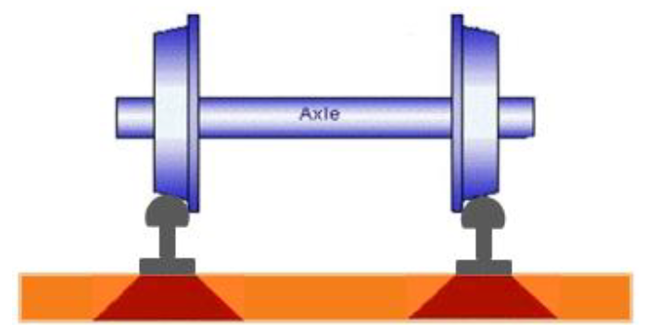
How to Improve Strength of Composite Type1 Sleepers
Because of the short length of the fillers, they do not have a major reinforcing effect and the failure behavior of these sleepers is mainly polymer driven.
Due to the lack of any long reinforcement fibres these sleepers are flexible and expand and contract significantly with temperature.
However, as stronger Type 2 and Type 3 composite sleepers become very expensive up to 10x more compared to wood sleepers, there is an incentive to develop further the low cost Type 1 sleepers to become stronger and more durable !

Slide 13
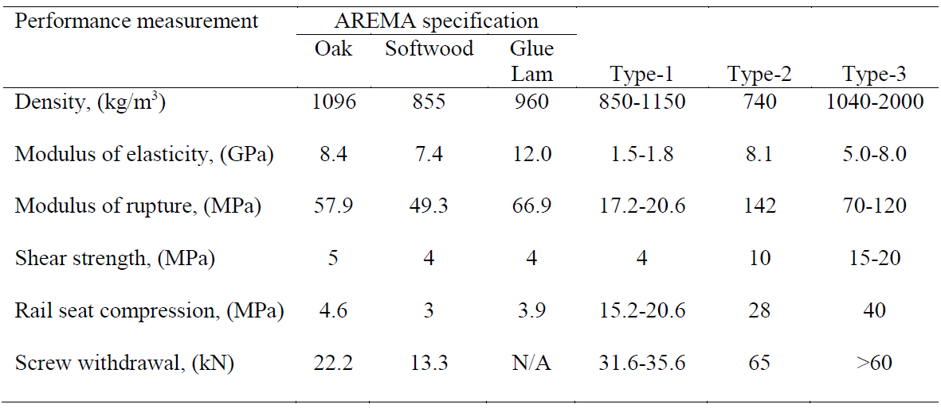
Comparing the Performance of Composite Sleepers to AREMA (USA) Specification Requirements
Source: Composite Railway Sleepers – Recent developments, challenges and future prospects / Article in Composite Structures · August 2015

Slide 14
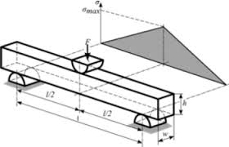
MOR- and MOE-values of Composite Type1 Sleepers
Modulus of Rupture (flexural strength) and Modulus of Elasticity (stiffness) values for composite materials are defined in 3-point bending test in laboratory conditions
The minimum values stated in AREMA (USA) specification (MOR @13.8 MPa and MOE @1.2 GPa) represent those levels typical for polyethylene (PE) polymer – and this is logical because Type 1 composite sleepers are made mainly from this waste material
When producing the composite material formulation one may combine other stronger waste materials in the PE-waste polymer for improving the mechanical performance of Type 1 sleepers into much higher level without increasing costs !!

Slide 15
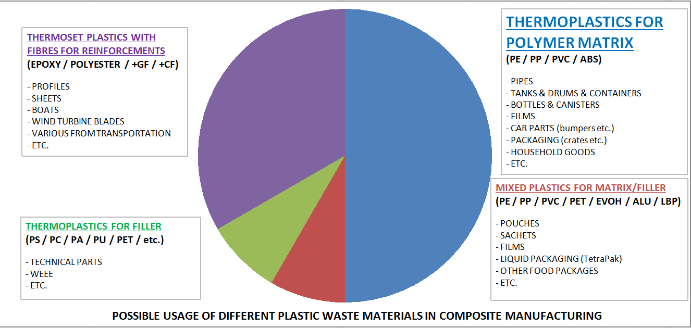
Choice of Materials for Type1 Composite Sleepers

Slide 16
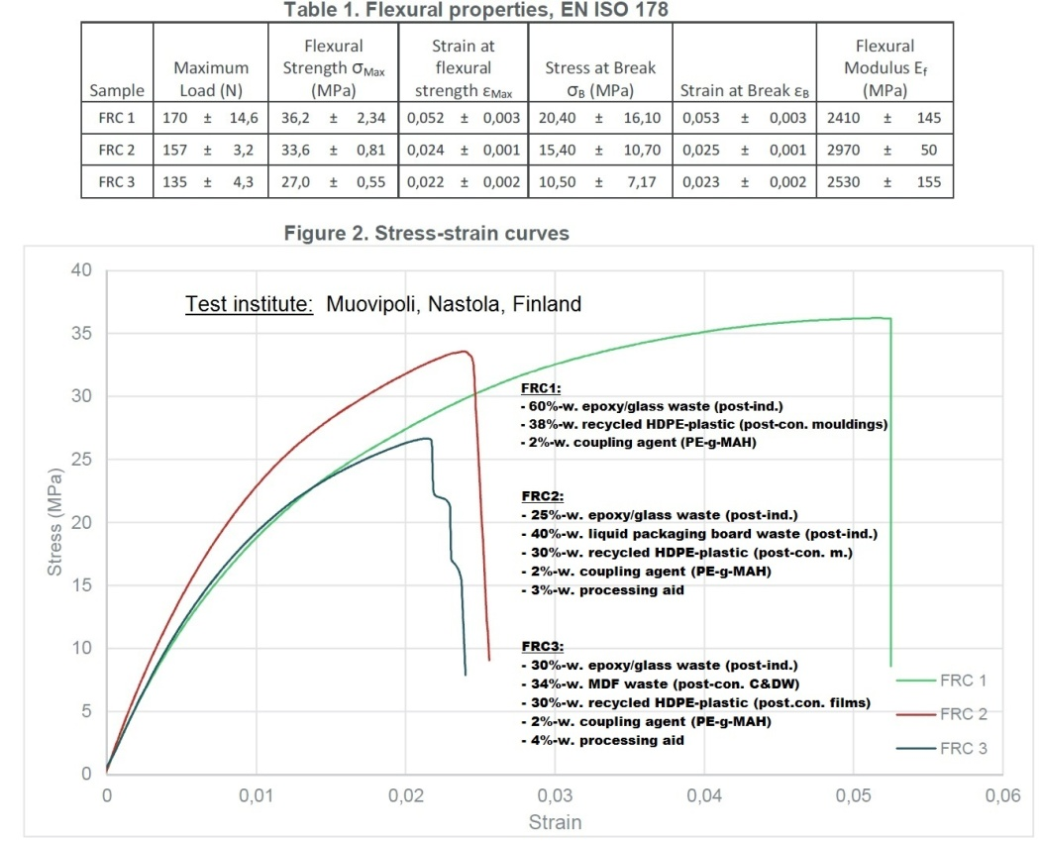
MOR- and MOE-values of Conenor Developed FRP-Waste Reinforced HDPE-Waste Plastic
MOR-values up to 36 MPa !
MOE-values up to 3 GPa !
Mechanical properties of ”FRC”-material from waste exceed AREMA requirements by 2,5 times and outperform those existing Type 1 composite sleepers in the market
Ideal for stronger Type 1
Composite Sleepers !

Slide 17
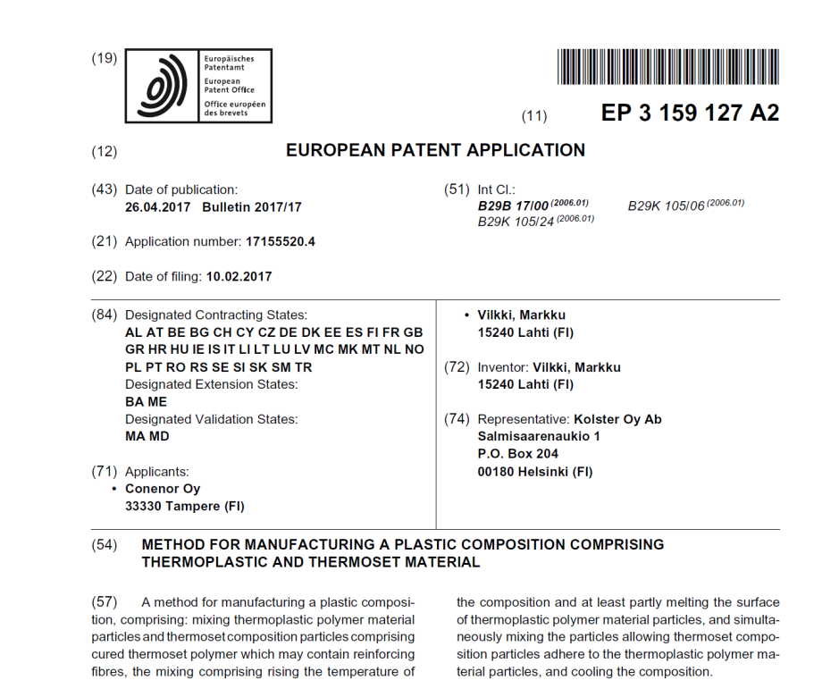
FRP-Waste Reinforced Material is an Invention by Conenor Ltd
Patent Application EP 3 159 127 A2
Simple and Low Cost Thermo-Mechanical Process
Using Commodity Existing Equipment
No Processing Waste
Applicable Stronger Material for Plastic Processing (injection, extrusion, intrusion)
Technology Available on License Basis
see http://www.conenor.com/recycling-thermoset-frpwaste/

Slide 18
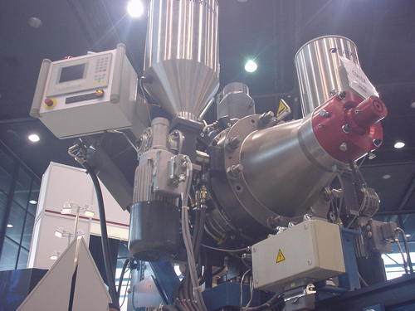
Conenor Ltd – a Private Development Company in Waste Composites
SME founded 1995
Inventor of unique CONEX®-Extrusion Technology
Participation in EU-Commission funded R&D-projects;
http://www.ircow.eu/
https://osirysproject.eu/
http://www.hiserproject.eu/
http://cordis.europa.eu/project/rcn/210181_en.html
Outsourced client R&D-projects from waste composites for major corporations (including among others);
UPM; see http://www.conenor.com/client-projects-trials/
StoraEnso
Kuusakoski / Metsähallitus
Composite extrusion facilities for R&D, sampling and pilot production at Orimattila Town in South-Finland
www.conenor.com

